Slide 1
PowerShell Monks
Event 00 - Practice

Slide 2
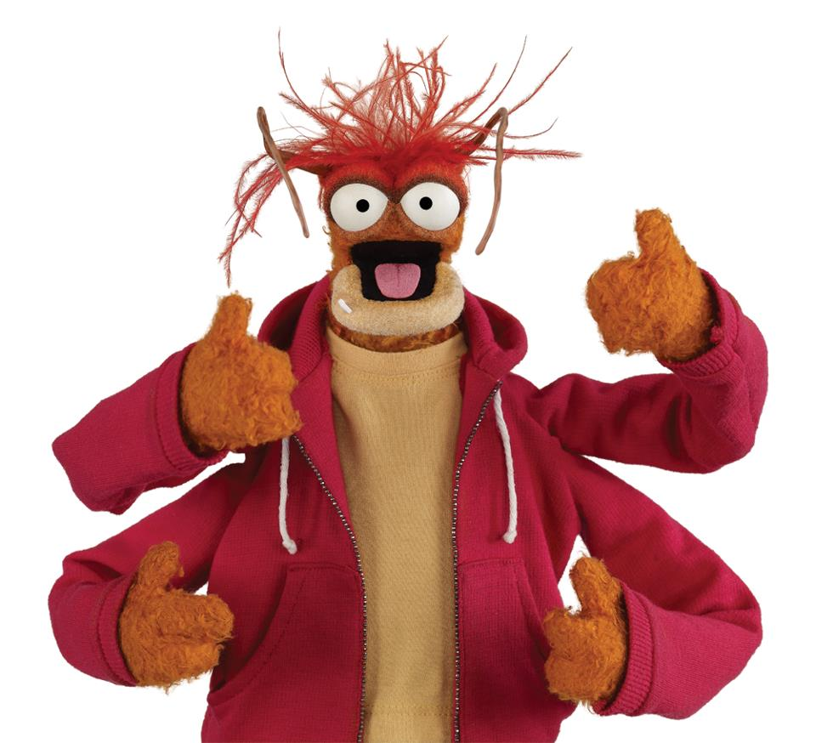
Pepe ze Praawn !!

Slide 3
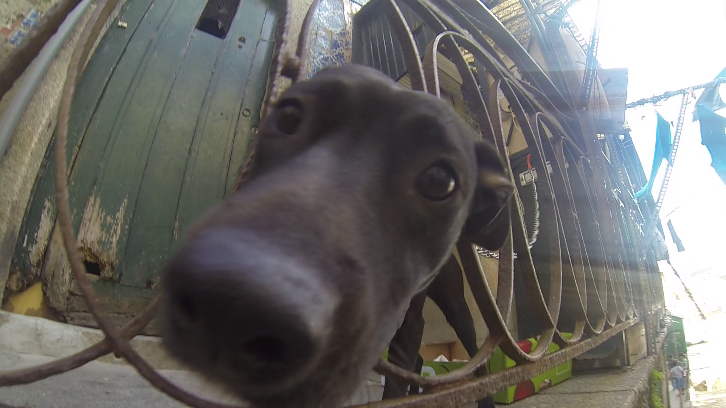
Woopy di woof!!

